Slide 1
The EU Green Deal: Prospects and Challenges
Introduction and key conceps
Hoang Hai Yen

Slide 2
CONTENT
Introduction
Overview of the EU Green Deal
Definition of the EU Green Deal and its importance
The historical context and background of the EU Green Deal
II. The Key Components of the EU Green Deal
Climate neutrality by 2050
The EU's efforts to address biodiversity loss
The EU's approach to sustainable and circular economy
The EU's plan for a fair transition to a green future

Slide 3
INTRODUCTION THE EU GREEN DEAL
The European Green Deal-EGD, hereinafter referred to as “EU Green Deal” is a comprehensive and long-term program of the European Union (EU) to respond to all global climate emergency from now to 2050. This document was published on December 12, 2019 by European Commission and approved via voting by European Council in January 15, 2020.

Slide 4
INTRODUCTION THE EU GREEN DEAL
In the Documents, the European Green Deal mentions 09 main policy directions, each of which includes specific regulations, strategies, financial resources for implementation in compliance with the roadmap designed to gradually reach goals.

Slide 5
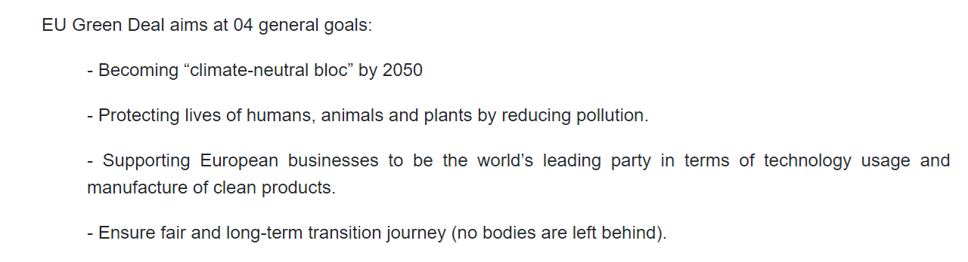
INTRODUCTION THE EU GREEN DEAL

Slide 6
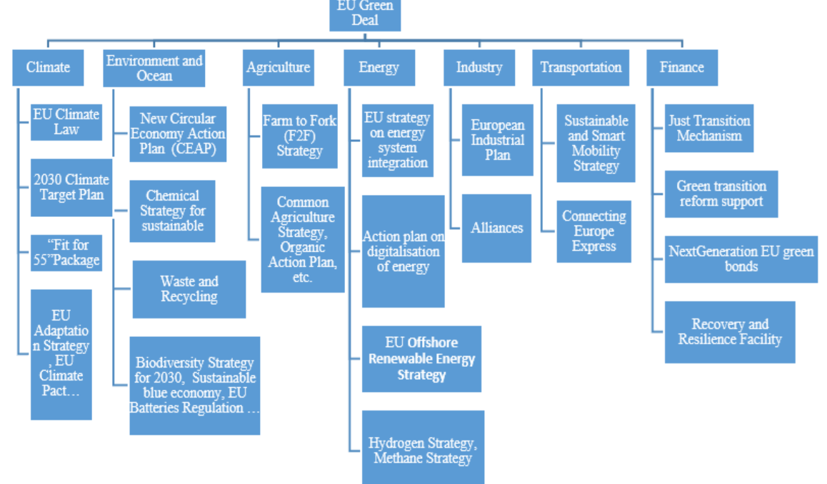
The Key Components of the EU Green Deal

Slide 7
.
THE KEY COMPONENTS OF THE EU GREEN DEAL
Climate neutrality by 2050
The Green Deal Strategy (and its Acton Plan) is transformative. It recognises that to meet the challenge of net zero requires action by everyone in every aspect of society and the economy.
European Commission is developing a wide range of Green Deal strategies including on biodiversity, agriculture, buildings, taxation (including a carbon border tax) and decarbonising the energy sector to transition to clean energy.
In 2021, major reforms to EU laws are expected including on renewables, emissions trading and clean hydrogen.

Slide 8
THE KEY COMPONENTS OF THE EU GREEN DEAL
The EU's efforts to address biodiversity loss
EU Biodiversity Strategy for 2030 is European Green Deal implementing action (categorized in Group of Environment and Ocean) which was published on 20 May 2020.
This is a comprehensive plan to protect and recover biodiversity in the EU, as well as EU's efforts in protecting global biodiversity.
The biodiversity strategy aims to put Europe’s biodiversity on the path to recovery by 2030 for the benefit of people, climate and the planet.

Slide 9
THE KEY COMPONENTS OF THE EU GREEN DEAL
The EU's efforts to address biodiversity loss
ACTIONS
Establishing a larger EU-wide network of protected areas on land and at sea
Launching an EU nature restoration plan
Introducing measures to enable the necessary transformative change
ntroducing measures to tackle the global biodiversity challenge

Slide 10
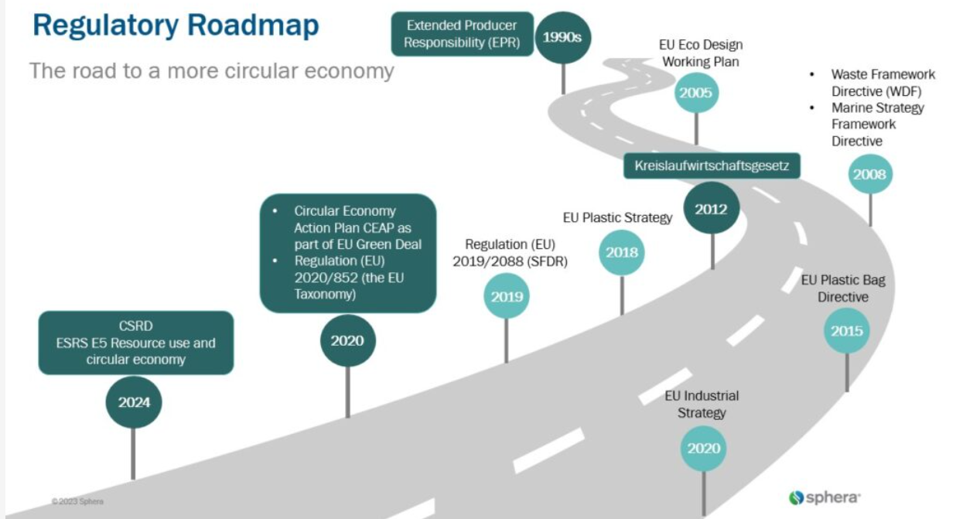
THE KEY COMPONENTS OF THE EU GREEN DEAL
The EU's approach to sustainable and circular economy

Slide 11
THE KEY COMPONENTS OF THE EU GREEN DEAL
The EU's approach to sustainable and circular economy
The Circular Economy Action Plan (CEAP) emphasizes key concepts such as waste hierarchy and the 9 R’s.
Regulation (EU) 2020/852, also known as the EU Taxonomy, establishes a framework to facilitate sustainable investment. It aims to create a “green list” of environmentally sustainable economic activities.
The EU’s stated aims include protecting natural resources while boosting sustainable growth, paving the way for a cleaner and more competitive Europe.
The circular economy holds significant business relevance by aligning ecological goals with economic interests. Through circular practices, companies can generate additional value. They optimize material use, reduce procurement risks and improve resource efficiency.

Slide 12
Thank you for your attention!
Yen Hai Hoang
School of Banking- UEH University)
E-mail: yenhh@ueh.edu.vn

